Slide 1
Gears-General
Text Book:
R. G. Budynas, J. K. Nisbett, Shigley’s Mechanical Engineering Design, Ninth Ed. in SI Units, Mc-Graw Hill 2011.

Slide 2

Types of Gears
Spur gears (düz dişliler), illustrated in Fig. 13–1, have teeth parallel to the axis of rotation and are used to transmit motion from one shaft to another, parallel, shaft.

Slide 3
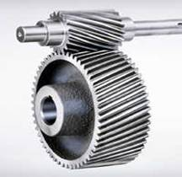
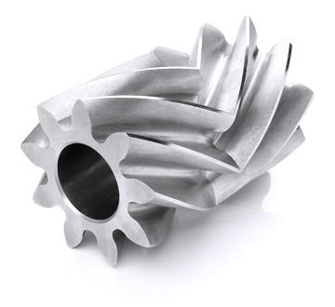
Helical gears (helis dişliler), shown in Fig. 13–2, have teeth inclined to the axis of rotation. Helical gears can be used for the same applications as spur gears and, when so used, are not as noisy, because of the more gradual engagement of the teeth during meshing. The inclined tooth also develops thrust loads and bending couples, which are not present with spur gearing.

Slide 4
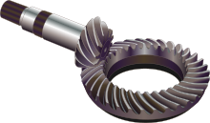
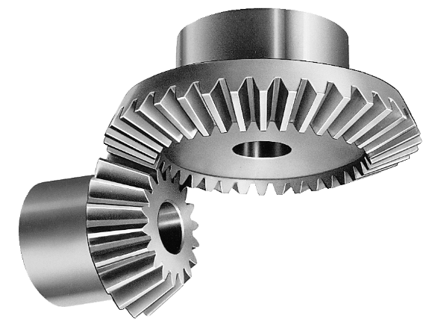
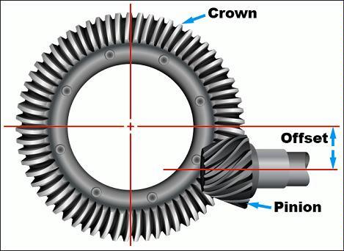
Bevel gears (konik dişliler), shown in Fig. 13–3, have teeth formed on conical surfaces and are used mostly for transmitting motion between intersecting shafts. The first figure illustrates straight-tooth bevel gears. Spiral bevel gears (the second figure) are cut so the tooth is no longer straight, but forms a circular arc. Hypoid gears are quite similar to spiral bevel gears except that the shafts are offset and nonintersecting.
Spiral bevel gearset (spiral konik dişliler)
Straight-tooth bevel gearset (düz konik dişliler)
Hypoid gearset (hipoid konik dişliler)

Slide 5
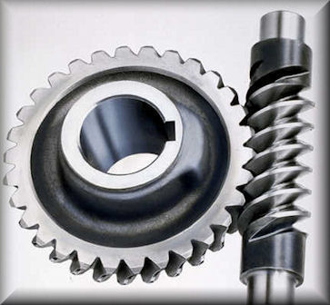
Worms and worm gears (sonsuz vida-dişli), shown in Fig. 13–4, represent the fourth basic gear type. As shown, the worm resembles a screw. The direction of rotation of the worm gear, also called the worm wheel, depends upon the direction of rotation of the worm and upon whether the worm teeth are cut right-hand or left-hand. Worm gearsets are also made so that the teeth of one or both wrap partly around the other. Such sets are called single-enveloping and double-enveloping worm gearsets. Worm gearsets are mostly used when the speed ratios of the two shafts are quite high, say, 3 or more.
Worm gearsets are used to transmit rotary motion between nonparallel and nonintersecting shafts.

Slide 6
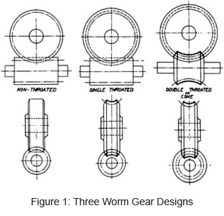
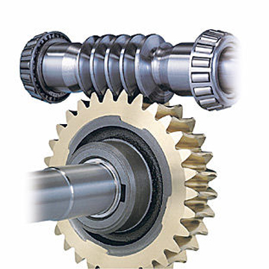
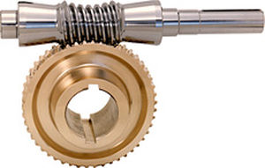
Single envelope worm gear
Worm gear: no envelope, single envelope and double envelope (sarmalsız, tek sarmallı ve çift sarmallı sonsuz vida-dişli).
Double envelope worm gear

Slide 7
Nomenclature
The pitch circle (bölüm dairesi) is a theoretical circle upon which all calculations are usually based; its diameter is the pitch diameter (d) (bölüm dairesi çapı). The pitch circles of a pair of mating gears are tangent to each other. A pinion (pinyon) is the smaller of two mating gears. The larger is often called the gear (dişli).
(Circular pitch (p): adım, Addendum (A): diş başı (üstü) yüksekliği, Dedendum (D): diş dibi yüksekliği, Tooth thickness: diş kalınlığı, Tooth (face) width: diş genişliği), Diametral pitch (P): çapsal adım)

Slide 8
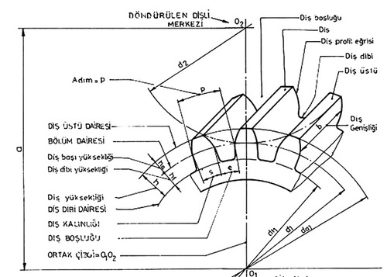

Slide 9
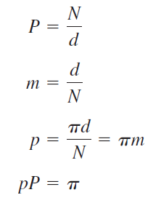

Slide 10
13–3 Conjugate Action
The point of contact occurs where the two surfaces are tangent to each other (point c), and the forces at any instant are directed along the common normal ab to the two curves. The line ab, representing the direction of action of the forces, is called the line of action. The line of action will intersect the line of centers O-O at some point P. The angular-velocity ratio between the two arms is inversely proportional to their radii to the point P.
Circles drawn through point P from each center are called pitch circles, and the radius
of each circle is called the pitch radius. Point P is called the pitch point.
If involute curves (profil eğrisi) are used, the gears tolerate changes in center-to-center distance with no variation in constant angular-velocity ratio.

Slide 11
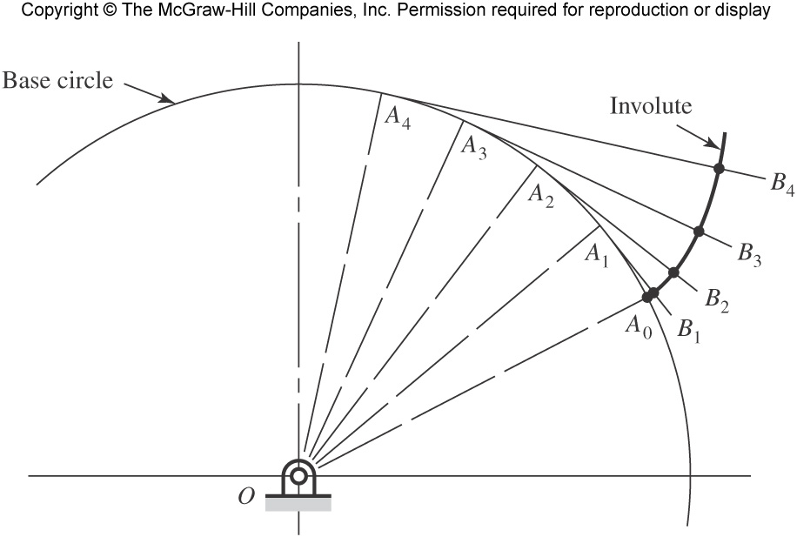
Involute profile ((L(A₁A₀)=L(A₁B₁), L(A₂A₀)=L(A₂B₁), …)
Base circle: taban dairesi

Slide 12
13–4 Involute Properties
as the cord def is unwrapped about the cylinder, point b will trace out the involute curve ac. At point b the radius is equal to the distance be, since point b is instantaneously rotating about point e. Thus the generating line de is normal to the involute at all points of intersection and, at the same time, is always tangent to the cylinder A. The circle on which the involute is generated is called the base circle.

Slide 13
When two gears are in mesh, their pitch circles roll on one another without slipping. Designate the pitch radii as r₁ and r₂ and the angular velocities as v₁ and v₂, respectively. Then the pitch-line velocity is

Slide 14
the radius of the base circle is
The line cd has three names, all of which are in general use. It is called the pressure line, the generating line, and the line of action. It represents the direction in which the resultant force acts between the gears. The angle Ф is called the pressure angle, and it usually has values of 20 or 25°.

Slide 16
The initial contact will take place when the flank of the driver comes into contact with the tip of the driven tooth. This occurs at point a in Fig. 13–12, where the addendum circle of the driven gear crosses the pressure line. If we now construct tooth profiles through point a and draw radial lines from the intersections of these profiles with the pitch circles to the gear centers, we obtain the angle of approach for each gear.
As the teeth go into mesh, the point of contact will slide up the side of the driving tooth so that the tip of the driver will be in contact just before contact ends. The final point of contact will therefore be where the addendum circle of the driver crosses the pressure line. This is point b in Fig. 13–12. By drawing another set of tooth profiles through b, we obtain the angle of recess for each gear in a manner similar to that of finding the angles of approach. The sum of the angle of approach and the angle of recess for either gear is called the angle of action. The line ab is called the line of action.

Slide 19
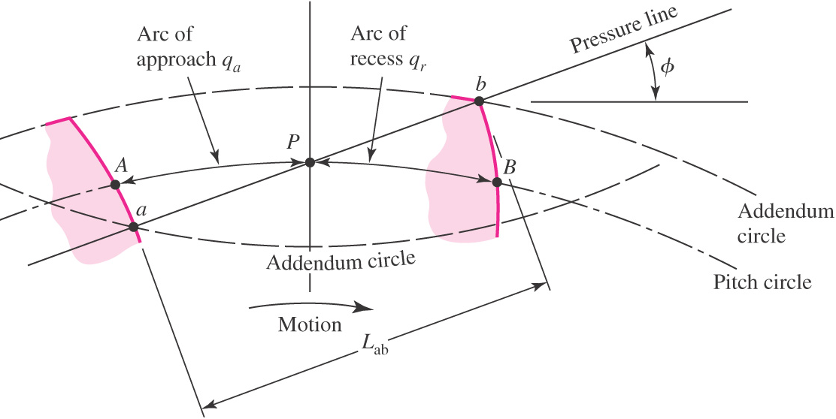
13–6 Contact Ratio
The contact ratio is the average number of pairs of teeth in contact. The contact ratio should be at least 1.2
Approx. length of arc AB
or
where q_{t} = q_{a} + q_{r}

Slide 20
13–7 Interference
Digging out

Slide 21
The contact of portions of tooth profiles that are not conjugate is called interference. Contact begins when the tip of the driven tooth contacts the flank of the driving tooth. In this case the flank of the driving tooth first makes contact with the driven tooth at point A, and this occurs before the involute portion of the driving tooth comes within range. In other words, contact is occurring below the base circle of gear 2 on the noninvolute portion of the flank. The actual effect is that the involute tip or face of the driven gear tends to dig out the noninvolute flank of the drive. When gear teeth are produced by a generation process, interference is automatically eliminated because the cutting tool removes the interfering portion of the flank. This effect is called undercutting; if undercutting is at all pronounced, the undercut tooth is considerably weakened.

Slide 22

On spur meshed with larger gear with gear ratio
m_{G} = N_{G}/N_{P} = m, the smallest number of teeth which will not have interference is
Largest gear with a specified pinion that is interference-free is

Slide 23
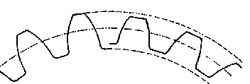
The smallest number of teeth on a spur pinion and gear, one-to-one gear ratio (m_{G} = N_{G}/N_{P} = m=1), which can exist without interference is;

Slide 24
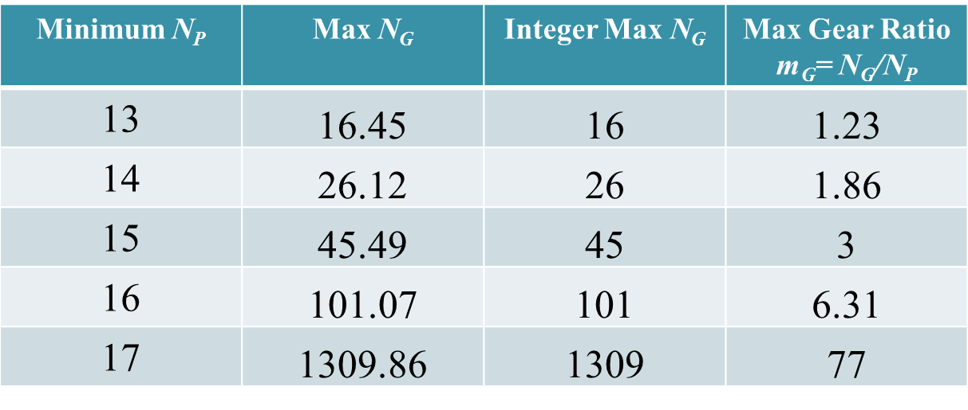
Interference of Spur Gears
For 20º pressure angle, the most useful values from Eqs. (13–11) and (13–12) are calculated and shown in the table below.

Slide 25
Increasing the pressure angle to 25º allows smaller numbers of teeth (note that the larger pressure angle increases the radial force for the same amount of transmitted force).
Minimum N_{P} | Max N_{G} | Integer Max N_{G} | Max Gear Ratio m_{G}= N_{G}/N_{P}
9 | 13.33 | 13 | 1.44
10 | 32.39 | 32 | 3.2
11 | 249.23 | 249 | 22.64

Slide 26
13–9 Straight Bevel Gears

Slide 27
When gears are used to transmit motion between intersecting shafts, some form of bevel gear is required. A bevel gearset is shown in Fig. 13–20. Although bevel gears are usually made for a shaft angle of 90°, they may be produced for almost any angle. The teeth may be cast, milled, or generated.
The pitch of bevel gears is measured at the large end of the tooth, and both the circular pitch and the pitch diameter are calculated in the same manner as for spur gears. It should be noted that the clearance is uniform. The pitch angles are defined by the pitch cones meeting at the apex, as shown in the figure. They are related to the tooth numbers as follows:
Figure 13–20 shows that the shape of the teeth, when projected on the back cone,
is the same as in a spur gear having a radius equal to the back-cone distance r_{b}. This is called Tredgold’s approximation. The number of teeth in this imaginary gear is
where N’ is the virtual number of teeth and p is the circular pitch measured at the large end of the teeth.

Slide 28
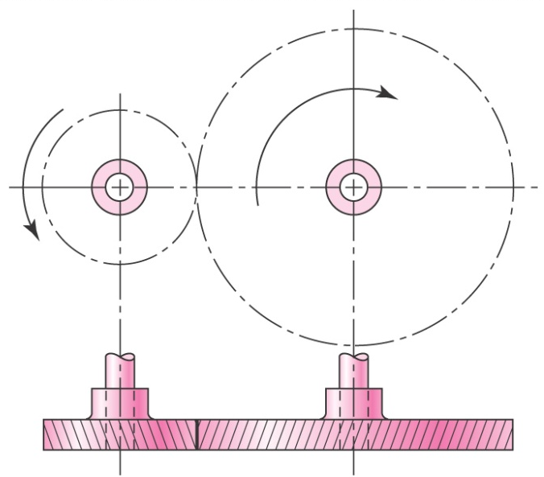
13–10 Parallel Helical Gears
Helical gears, used to transmit motion between parallel shafts. The helix angle is the same on each gear, but one gear must have a right-hand helix and the other a left-hand helix. The shape of the tooth is an involute helicoid. If a piece of paper cut in the shape of a parallelogram is wrapped around a cylinder, the angular edge of the paper becomes a helix. If we unwind this paper, each point on the angular edge generates an involute curve. This surface obtained when every point on the edge generates an involute is called an involute helicoid.

Slide 29
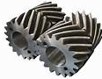
In spur gears the line of contact is parallel to the axis of rotation; in helical gears the line is diagonal across the face of the tooth. It is this gradual engagement of the teeth and the smooth transfer of load from one tooth to another that gives helical gears the ability to transmit heavy loads at high speeds. Because of the nature of contact between helical gears, the contact ratio is of only minor importance, and it is the contact area, which is proportional to the face width of the gear, that becomes significant.
Helical gears subject the shaft bearings to both radial and thrust loads. When the thrust loads become high or are objectionable for other reasons, it may be desirable to use double helical gears. A double helical gear (herringbone) is equivalent to two helical gears of opposite hand, mounted side by side on the same shaft. They develop opposite thrust reactions and thus cancel out the thrust load.
Herringbone-double helical gear

Slide 30
The distance ac is the transverse circular pitch p_{t} in the plane of rotation (usually called the circular pitch). The distance ae is the normal circular pitch p_{n} and is related to the transverse circular pitch as follows:

Slide 31
The distance ad is called the axial pitch p_{x} and is related by the expression

Slide 33
13–12 Tooth Systems
A tooth system is a standard that specifies the relationships involving addendum, dedendum, working depth, tooth thickness, and pressure angle. The standards were originally planned to attain interchangeability of gears of all tooth numbers, but of the same pressure angle and pitch.

Slide 36
13–13 Gear Trains (dişli setleri, dişli takımları)
Consider a pinion 2 driving a gear 3. The speed of the driven gear is
The absolute-value signs are used to permit complete freedom in choosing positive and negative directions. In the case of spur and parallel helical gears, the directions in the viewing plane ordinarily correspond to the right-hand rule—positive for counterclockwise rotation and negative for clockwise rotation.

Slide 37
(Aktarma oranı)
Fig. 13–28

Slide 38
Simple Gear Train:
When there is only one gear on each shaft, it is known as simple gear train. The gears are represented by their pitch circles. Since the gear 1 drives the gear 2, therefore gear 1 is called the driver and the gear 2 is called the driven or follower.

Slide 39
Compound Gear Train:
When there is more than one gear on a shaft, it is called a compound train of gear.
In this case, each intermediate shaft has two gears rigidly fixed to it so that they may have the same speed. One of these two gears meshes with the driver and the other with the driven or follower attached to the next shaft.

Slide 40
Reverted Gear Train:
When the axes of the first gear (i.e. first driver) and the last gear (i.e. last driven or follower) are co-axial, then the gear train is known as reverted gear train as shown in

Slide 41
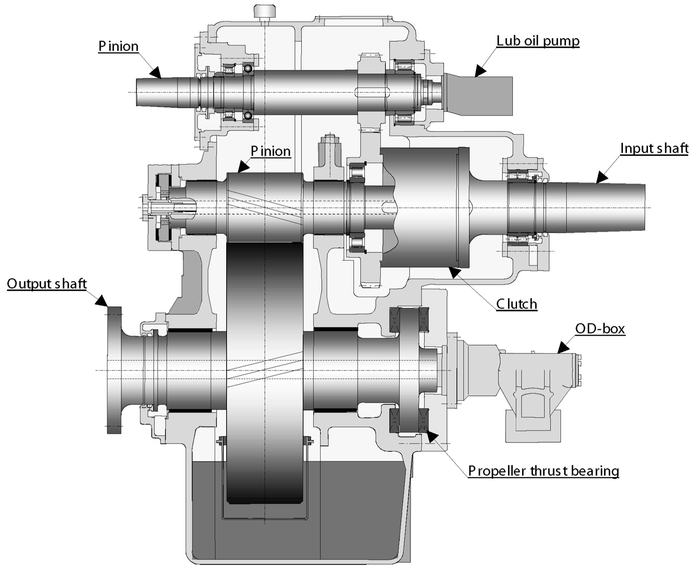
Marine Technology
Cross-section of the single stage single input gear with clutch and primary PTO (power take off). OD box: oil distribution box.

Slide 42
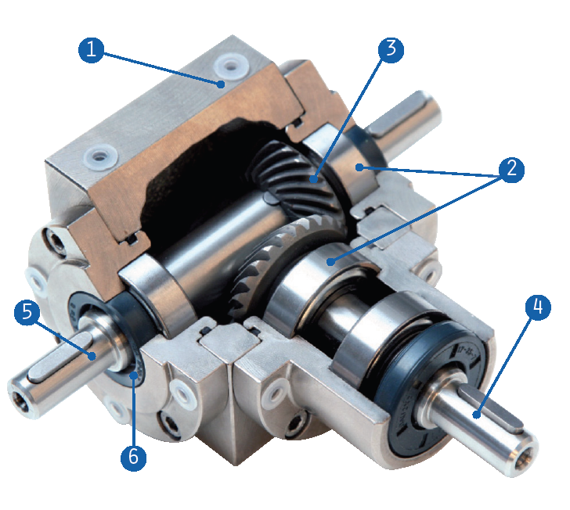
GAM Spiral Bevel Gearboxes: Automation technology
1. Housing: Sturdy cast iron housing (Aluminum in size 35mm and 45mm) - all 6 sides can be used for mounting
2. Bearings: Deep groove ball bearings handle axial and radial loading. (Reinforced and taper roller options available)
3. Spiral Bevel Gearing: Precision cut, hardened, and lapped in pairs for ideal tooth contact. Mathematically precise ratios from 1:1 to 6:1
4. Input: Available with shaft input or integrated motor adapter and coupling to easily mount to any IEC, NEMA, or servo motor
5. Output: Solid shaft with key or keyed hollow shaft are standard. (Smooth shaft or shrink disc clamping available)
6. Seals: Lubricated for life and protected with high quality NBR seals. (Viton® and FPM seals available)

Slide 43
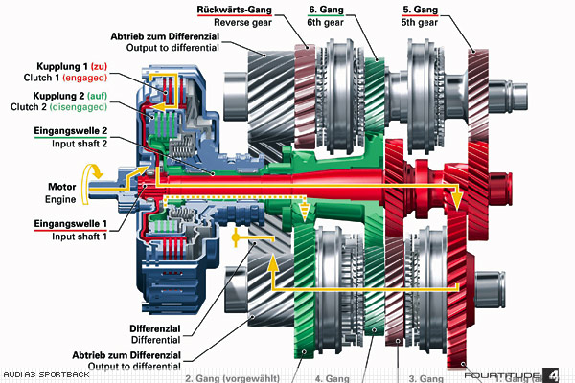
Dual-clutch transmission: Automobile Technology

Slide 44
Since numbers of teeth on gears must be integers, it is better to determine them first, and then obtain pitch diameters second. Determine the number of stages necessary to obtain the overall ratio, then divide the overall ratio into portions to be accomplished in each stage. To minimize package size, keep the portions as evenly divided between the stages as possible. In cases where the overall train value need only be approximated, each stage can be identical.
For example, in a two-stage compound gear train, assign the square root of the overall train value to each stage. If an exact train value is needed, attempt to factor the overall train value into integer components for each stage. Then assign the smallest gear(s) to the minimum number of teeth allowed for the specific ratio of each stage, in order to avoid interference (see Sec. 13–7). Finally, applying the ratio for each stage, determine the necessary number of teeth for the mating gears. Round to the nearest integer and check that the resulting overall ratio is within acceptable tolerance.

Slide 47
Force Analysis—Spur Gearing
Beginning with the numeral 1 for the frame of the machine, we shall designate the input gear as gear 2, and then number the gears successively 3, 4, etc.
We shall designate the shafts, using lowercase letters of the alphabet, a, b, c, etc.
The force exerted by gear 2 against gear 3 as F₂₃
The coordinate directions will usually be indicated by the x, y, and z coordinates, and the radial and tangential directions by superscripts r and t. With this notation, F^{t}₄₃ is the tangential component of the force of gear 4 acting against gear 3.

Slide 48


Transmitted load
Torque
Power

Slide 50
Force Analysis—Bevel Gearing
The usual practice is to use the tangential or transmitted load that would occur if all the forces were concentrated at the midpoint of the tooth

Slide 51
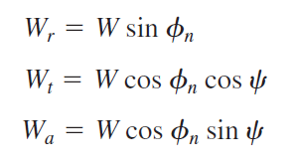
Force Analysis—Helical Gearing

