Slide 1
Spur and Helical Gears
Text Book:
R. G. Budynas, J. K. Nisbett, Shigley’s Mechanical Engineering Design, Ninth Ed. in SI Units, Mc-Graw Hill 2011.

Slide 2

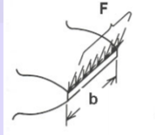
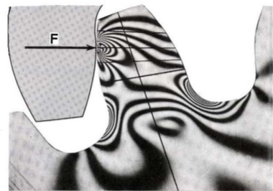
14–1 The Lewis Bending Equation

Slide 3

The factor y is called the Lewis form factor
$$Y=πy$$
The use of this equation for Y means that only the bending of the tooth is considered and that the compression due to the radial component of the force is neglected.

Slide 5
Dynamic Effects
When a pair of gears is driven at moderate or high speed and noise is generated, it is certain that dynamic effects are present. One of the earliest efforts to account for an increase in the load due to velocity employed a number of gears of the same size, material, and strength. Several of these gears were tested to destruction by meshing and loading them at zero velocity. The remaining gears were tested to destruction at various pitch-line velocities. For example, if a pair of gears failed at 500 lbf tangential load at zero velocity and at 250 lbf at velocity V₁, then a velocity factor, designated K_{v}, of 2 was specified for the gears at velocity V₁. Then another, identical, pair of gears running at a pitch-line velocity V1 could be assumed to have a load equal to twice the tangential or transmitted load.

Slide 7
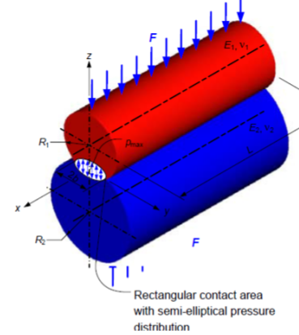
14–2 Surface Durability
In this section we are interested in the failure of the surfaces of gear teeth, which is
generally called wear. Pitting, as explained in Sec. 6–16, is a surface fatigue failure due to many repetitions of high contact stresses. Other surface failures are scoring, which is a lubrication failure, and abrasion, which is wear due to the presence of foreign material.
To obtain an expression for the surface-contact stress, we shall employ the Hertz theory. In Eq. (3–74), p. 138, it was shown that the contact stress between two cylinders may be computed from the equation

Slide 8
the surface compressive stress (Hertzian stress) is found from the equation

Slide 9
,
14–3 AGMA Stress Equations
Two fundamental stress equations are used in the AGMA methodology, one for bending stress and another for pitting resistance (contact stress).

Slide 10
AGMA Bending Stress equations

Slide 11
AGMA Contact Stress equations (for pitting resistance).

Slide 12
14–4 AGMA Strength Equations
Instead of using the term strength, AGMA uses data termed allowable stress numbers
and designates these by the symbols s_{at} and s_{ac}.
To make it perfectly clear we shall use the term gear strength as a replacement for the phrase allowable stress numbers as used by AGMA.

Slide 13
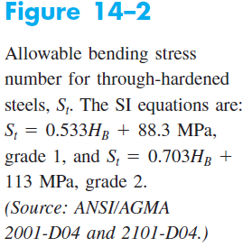

Slide 14
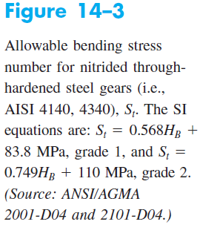

Slide 20
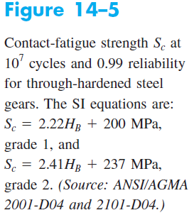

Slide 24
14–5 Geometry Factors I and J (Z_{I} and Y_{J})
We have seen how the factor Y is used in the Lewis equation to introduce the effect of tooth form into the stress equation. The AGMA factors I and J are intended to accomplish the same purpose in a more involved manner.
The determination of I and J depends upon the face-contact ratio m_{F}. This is
defined as

Slide 25
Bending-Strength Geometry Factor J (Y_{J})

Slide 28
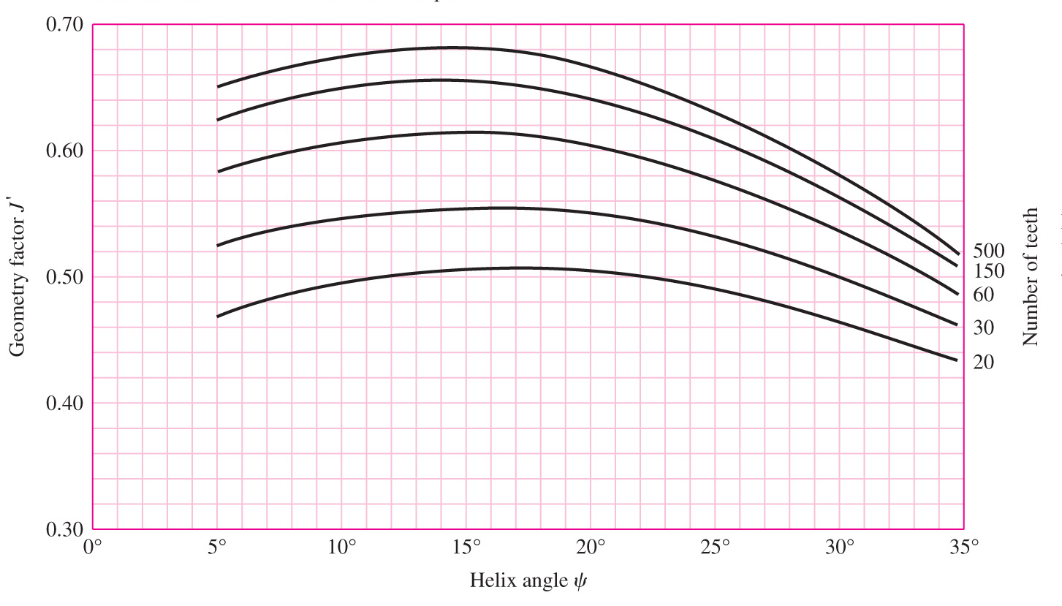
FOR HELICAL GEARS; Get J from Fig. 14–7, which assumes the mating gear has 75 teeth
Get multiplier from Fig. 14–8 for mating gear with other than 75 teeth (you may not use Fig. 14–8 since values are very close to 1).
Fig. 14–7

Slide 29
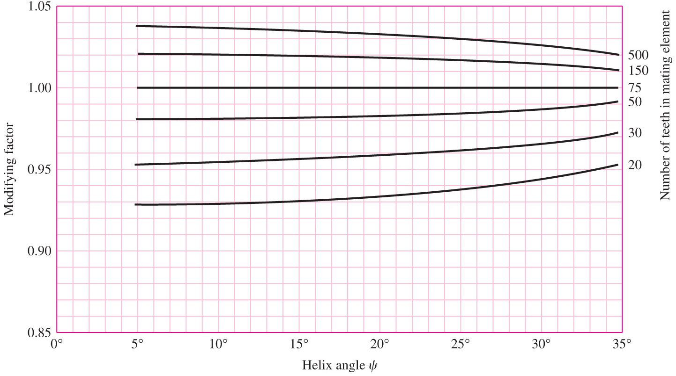
Modifying Factor for J
Fig. 14–8

Slide 30
Surface-Strength Geometry Factor I (Z_{I})
The factor I is also called the pitting-resistance geometry factor by AGMA.

Slide 31
I

Slide 33
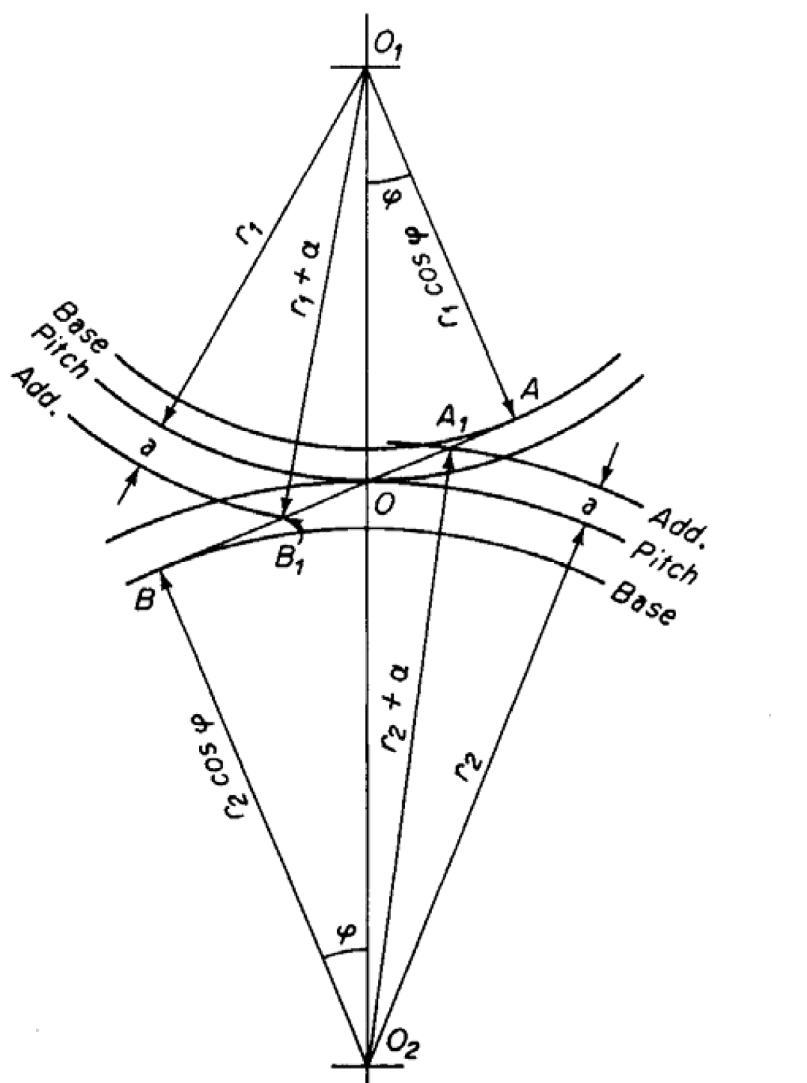
Z: Line of action = L_{a} = A₁B₁
Z = AB₁ + A₁B - AB

Slide 38
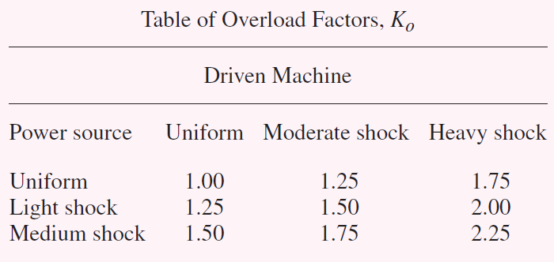

Slide 39
Take it 1

Slide 41
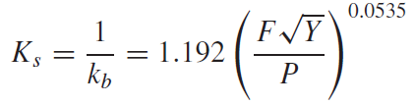
14-10 Size Factor K_{s}
Accounts for fatigue size effect, and non-uniformity of material properties for large sizes
AGMA has not established size factors
Use 1 for normal gear sizes
Could apply fatigue size factor method from Ch. 6, where this size factor is the reciprocal of the Marin size factor k_{b}. Applying known geometry information for the gear tooth,

Slide 43
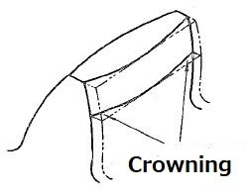
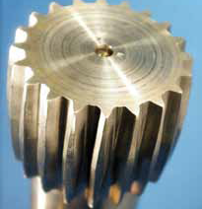

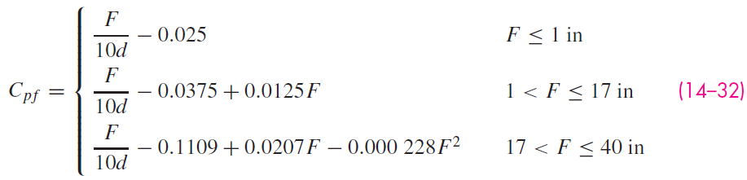
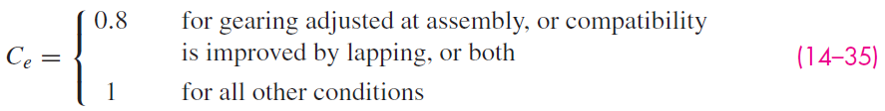
Load-Distribution Factor K_{m} (K_{H})
Face load-distribution factor
(crowning is done to reduce gear noise, minimize misalignment of gears, uneven wears of gears)

Slide 44
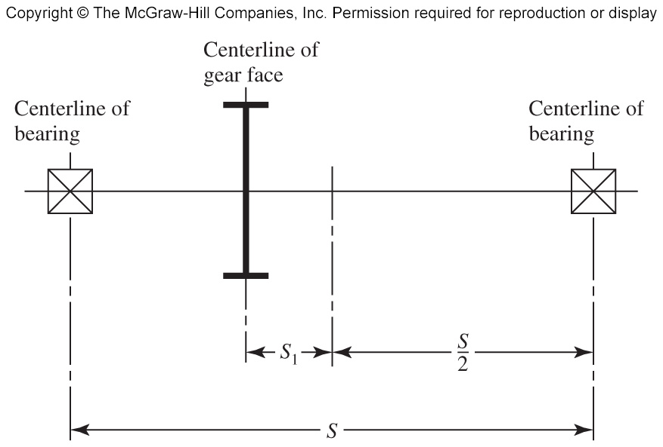
Load-Distribution Factor K_{m} (K_{H})
Fig. 14–10

Slide 45
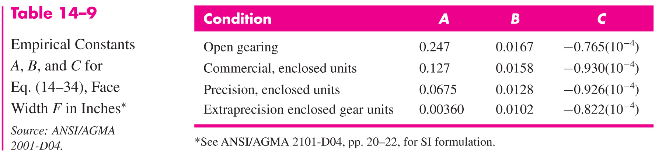
Load-Distribution Factor K_{m} (K_{H})
C_{ma} (mesh alignment factor) can be obtained from Eq. (14–34) with Table 14–9
Or can read C_{ma} directly from Fig. 14–11

Slide 46
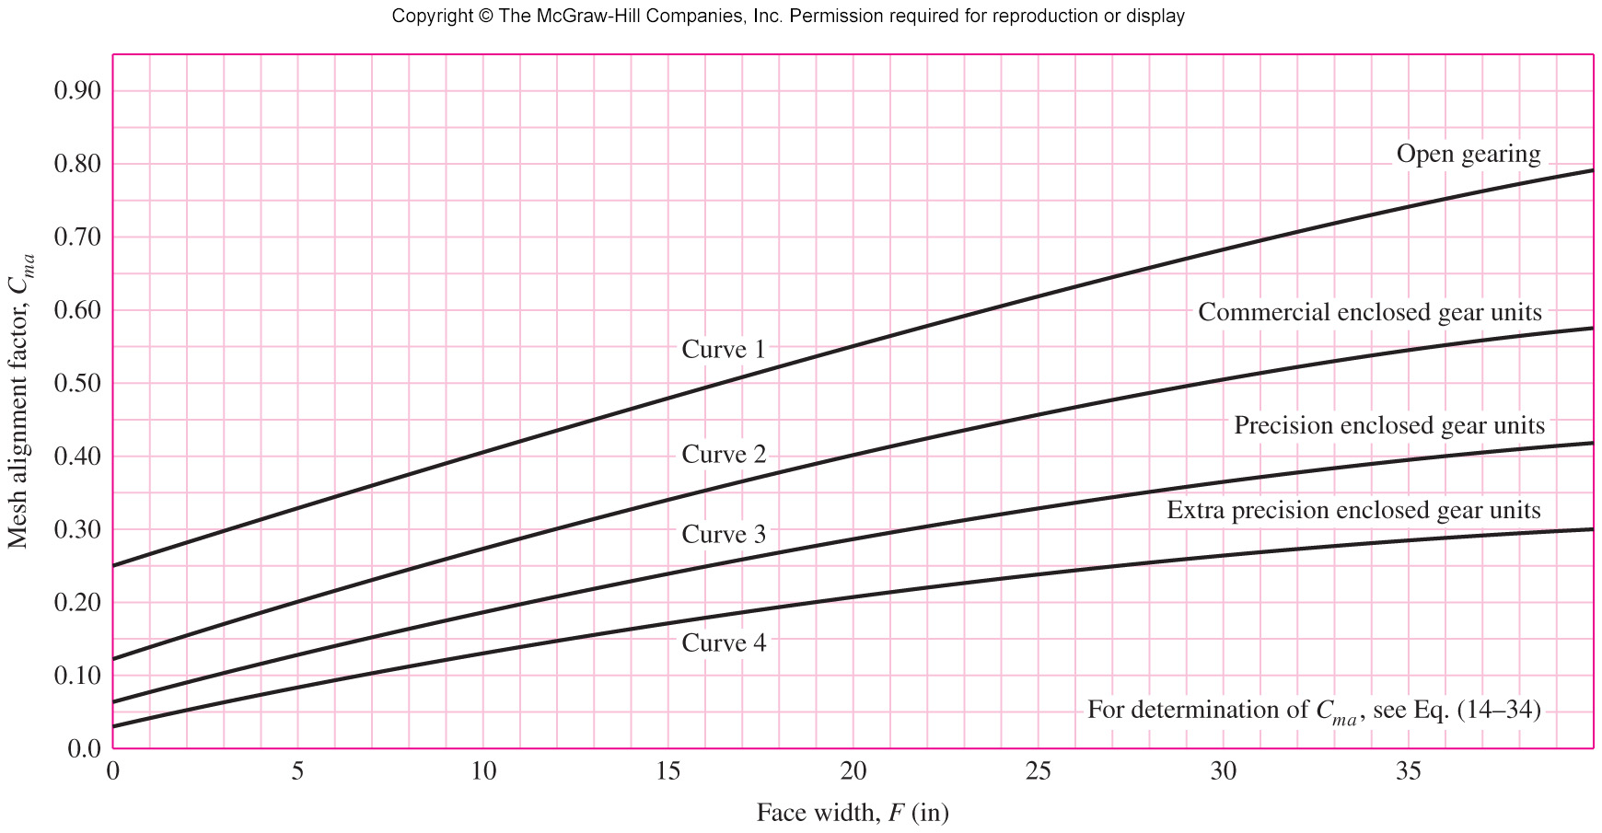
Load-Distribution Factor K_{m} (K_{H})
Fig. 14–11

Slide 48
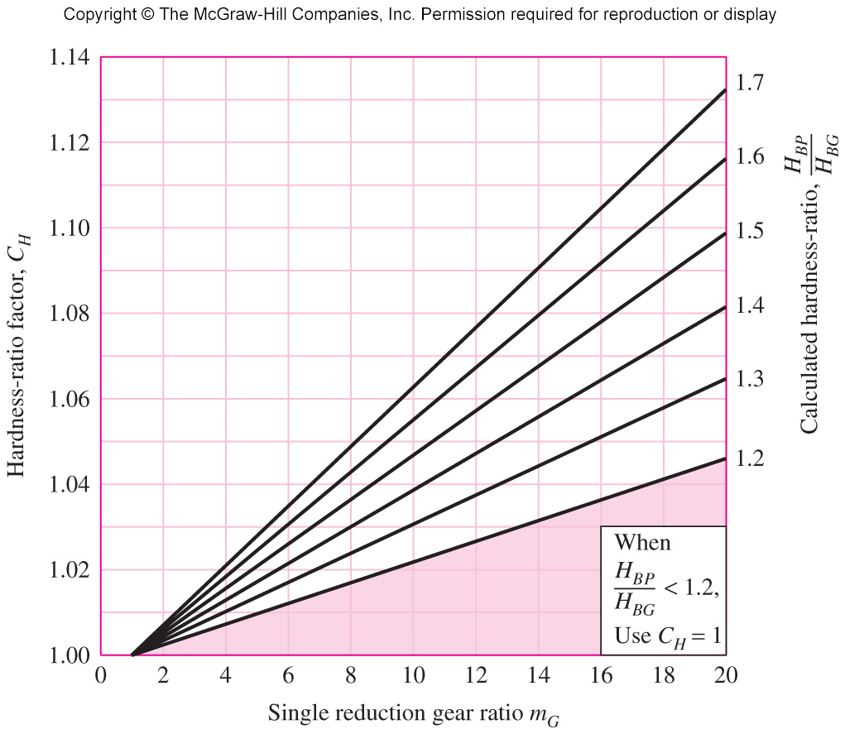
Hardness-Ratio Factor C_{H}
Fig. 14–12

Slide 49
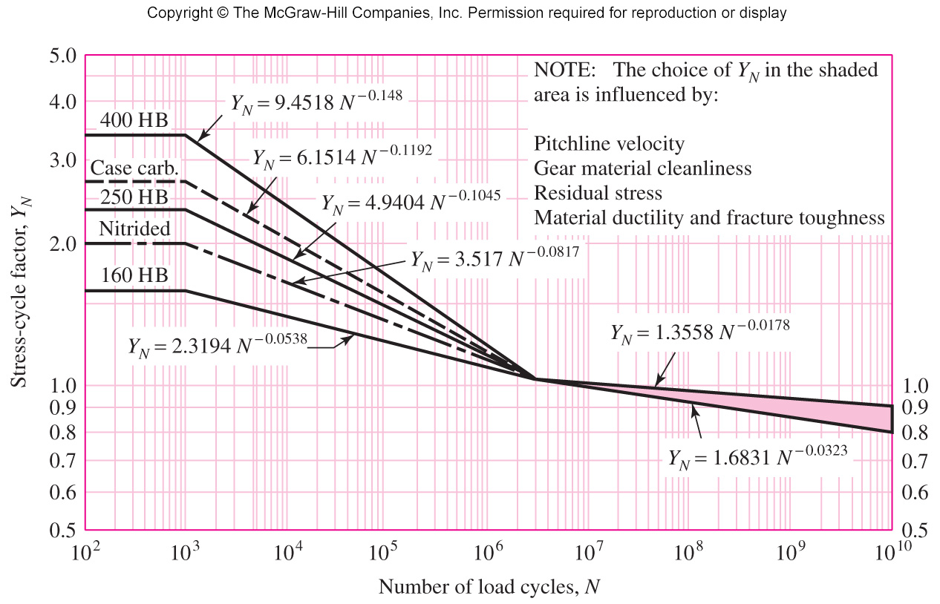
Fig. 14–14

Slide 50
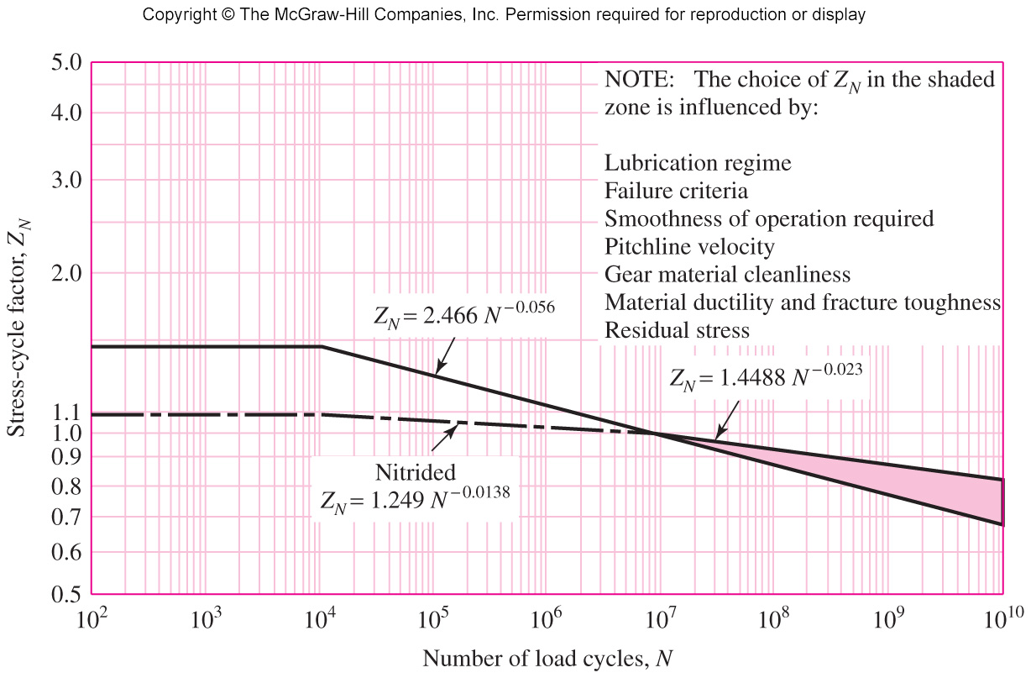
Stress-Cycle Factor Z_{N}
Fig. 14–15

Slide 55
Comparison of Factors of Safety
Bending stress is linear with transmitted load.
Contact stress is not linear with transmitted load
To compare the factors of safety between the different failure modes, to determine which is critical,
  Compare S_{F} with S_{H}² for linear or helical contact
  For crowned tooth profile: Compare S_{F} with S_{H}³ for spherical contact

Slide 56
14–18 Analysis

Slide 61
The steps, after the a priori decisions have been made are

Slide 62
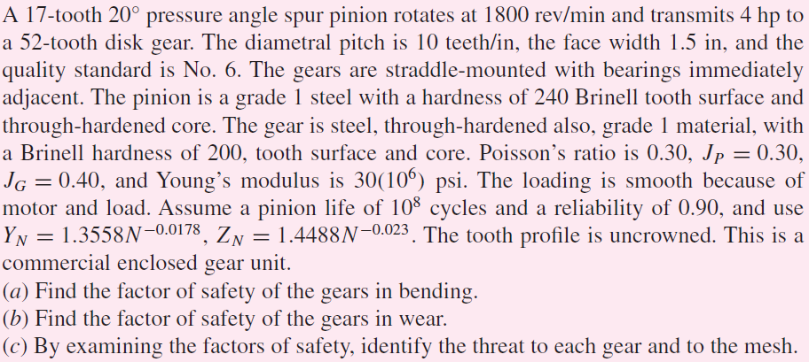
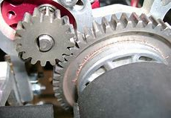
Example 14–4

Slide 63
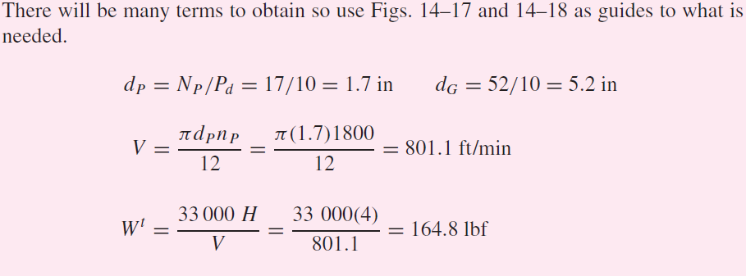
Example 14–4

Slide 64
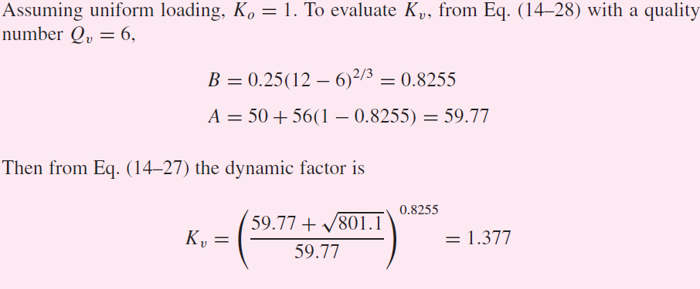
Example 14–4

Slide 65
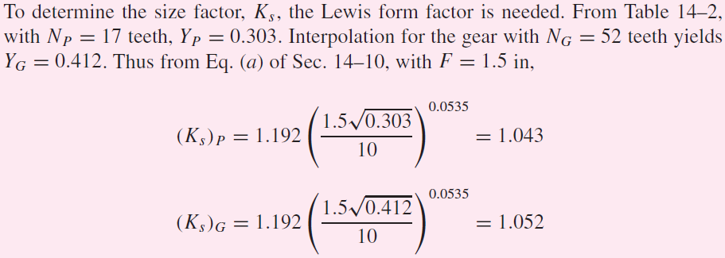
Example 14–4

Slide 66
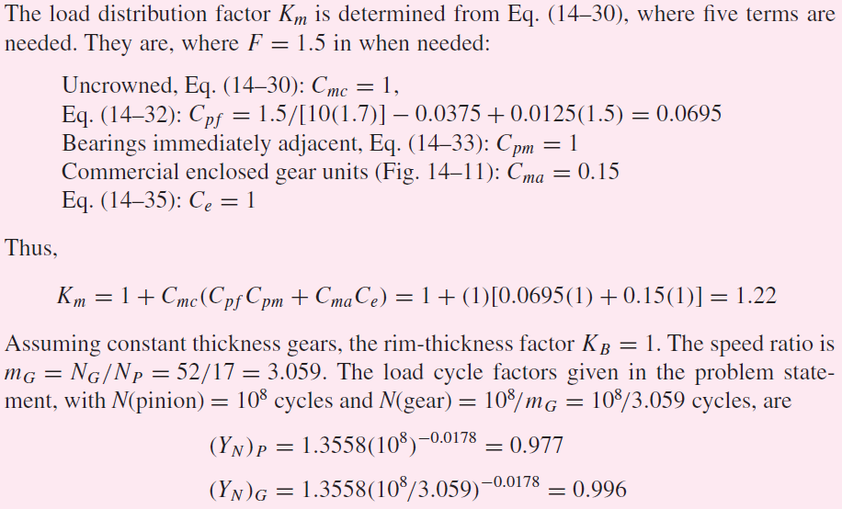
Example 14–4

Slide 67
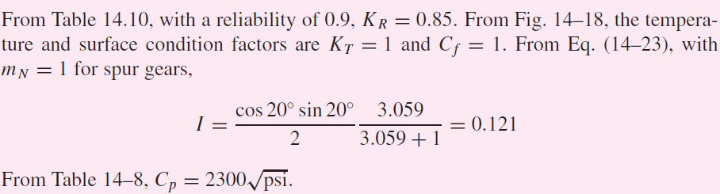
Example 14–4

Slide 68
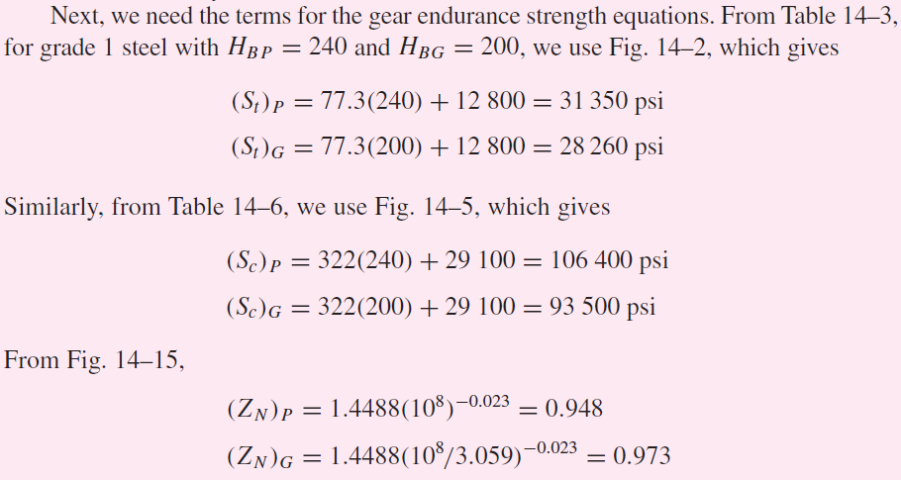
Example 14–4

Slide 69
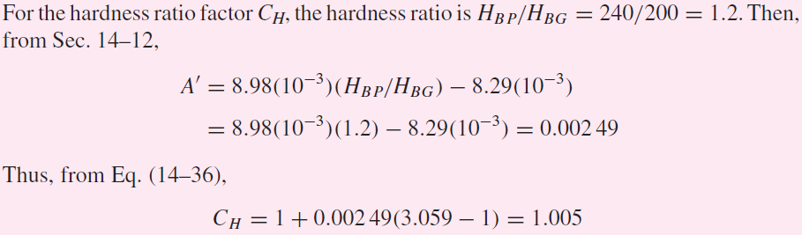
Example 14–4

Slide 70
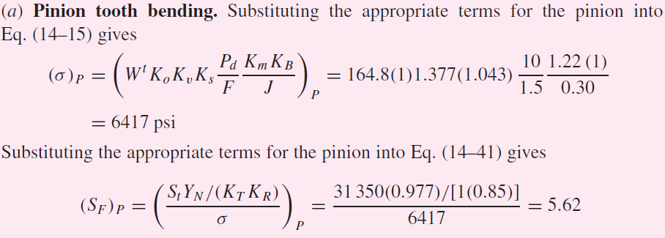
Example 14–4

Slide 71
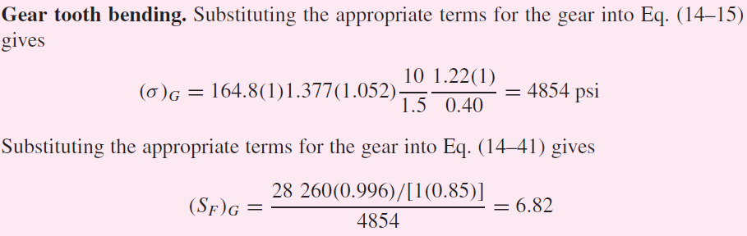
Example 14–4

Slide 72
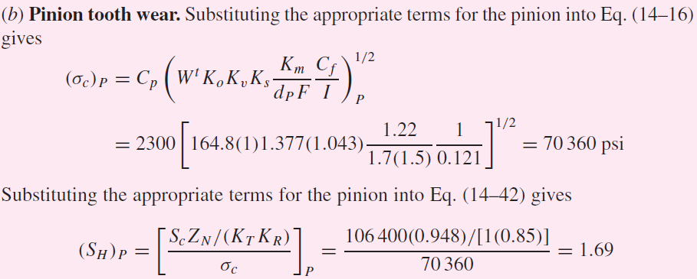
Example 14–4

Slide 73
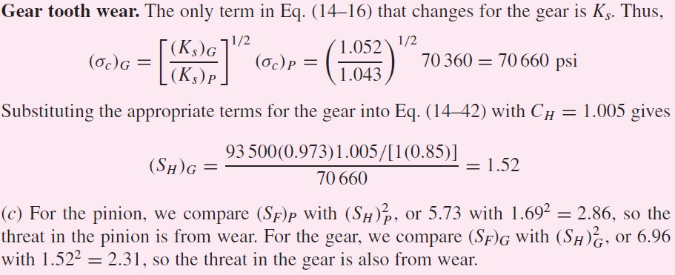
Example 14–4

Slide 74
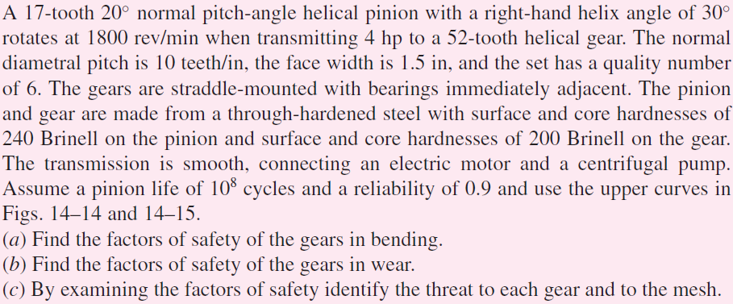
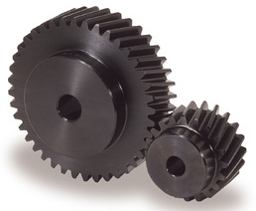
Example 14–5

Slide 75
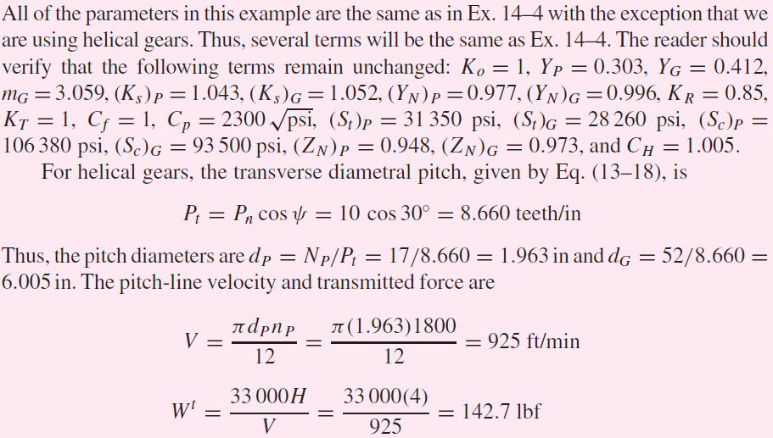
Example 14–5

Slide 76
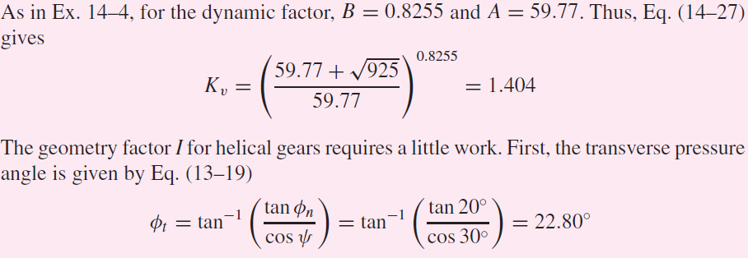
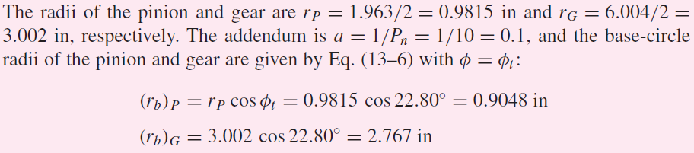
Example 14–5

Slide 77
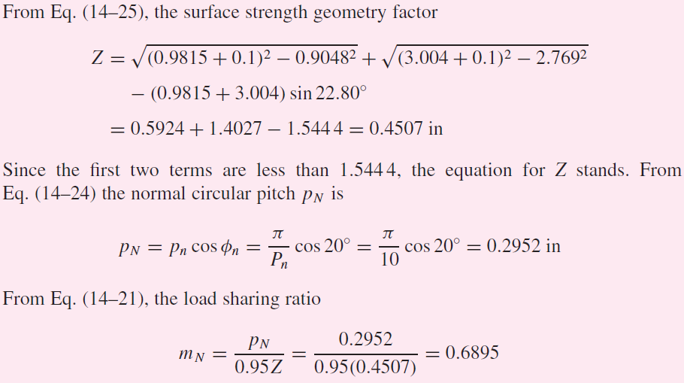
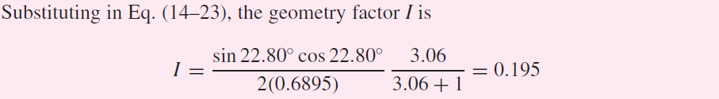
Example 14–5

Slide 78
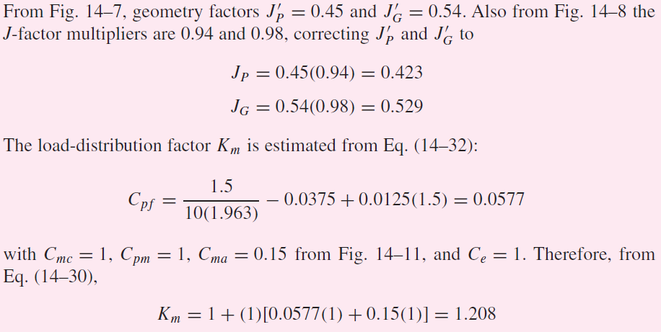
Example 14–5

Slide 79
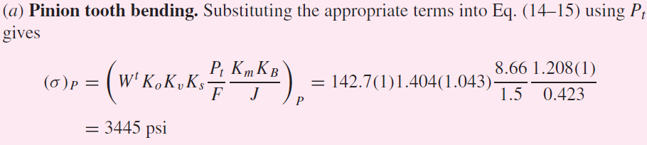
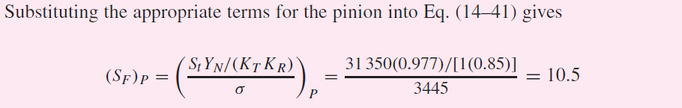
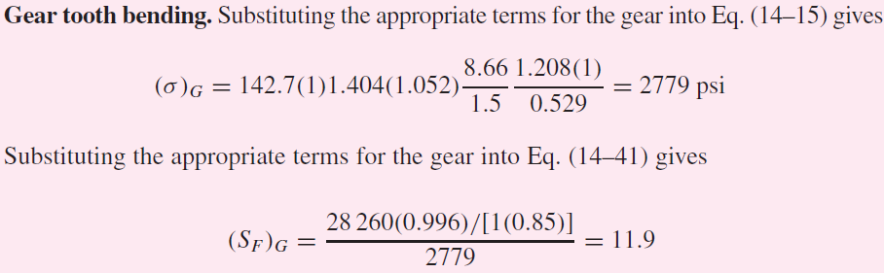
Example 14–5

Slide 80
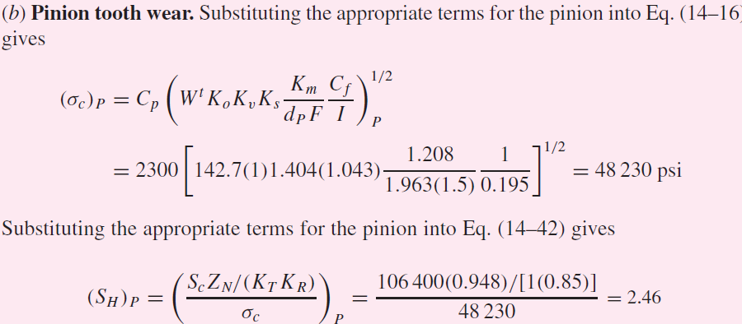
Example 14–5

Slide 81
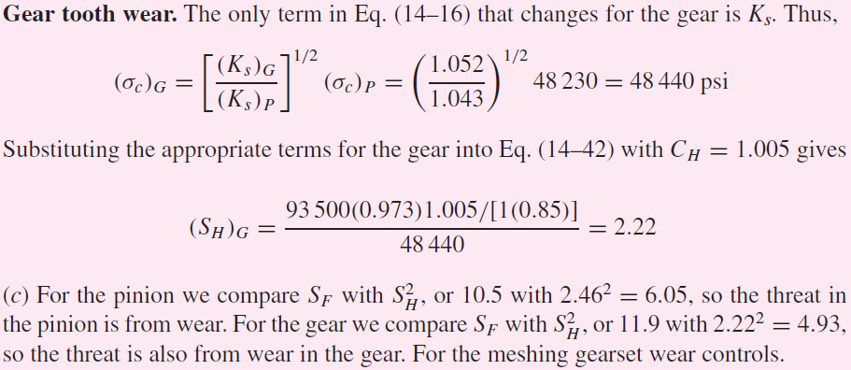
Example 14–5

